Slide 1
Jermyn Borough Council Meeting
10/16/2025

Slide 2

Meeting Agenda
OCTOBER 16, 2005
CALL TO ORDER
PLEDGE OF ALLEGIANCE
ROLL CALL
PREVIOUS MEETING MINUTES
TREASURE REPORT/BILLS PAYABLE
CORRESPONDENCE
SECRETARY REPORT
PUBLIC COMMENT
PROFESSIONAL REPORTS
COMMITTEE REPORTS
DATA CENTERS
TRASH BID APPROVAL FOR ADVERTISING
EASEMENTS FOR CREEK PROJECT
NEW BUSINESS
ADJOURNMENT

Slide 3
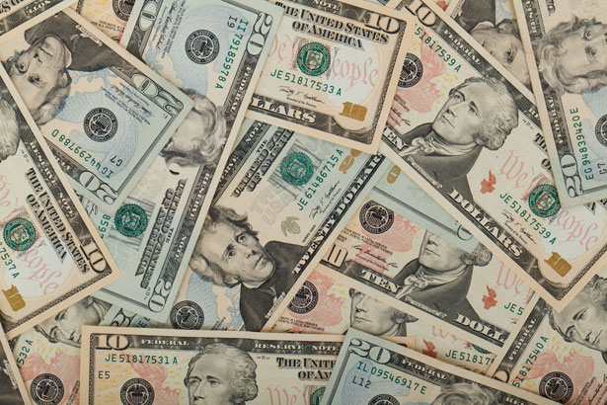
Treasurer’s report
10/16/2025
ASSETS
Checking/Savings
American Rescue Plan Fund 92,598.72
Capital Reserve - DPW 1,207.95
Capital Reserve - Police 6,959.82
Crime Watch Fund 222.69
General Fund - Community 75,358.24
General Fund - FNB 4,186.80
Holiday Lights Fund 400.59

Slide 4
Treasurer’s report
Investment - General Fund 1,157.83
Investment - Liquid Fuels 25,492.76
Investment - Paving Fund 1,169.86
Investment - Recycling 127.84
Investment - Refuse 182.32
Liquid Fuels - FNB 30,689.92
Petty Cash 194.00
Recreations Fund 23,405.80
Recycling - Community 8,486.87
Refuse Checking - FNB 231,981.65
Total Checking/Savings 503,823.66

Slide 5
Treasurer’s report
200000 · Accounts Payable 42,746.78
Long Term Debt 0

Slide 6


